Slide 1
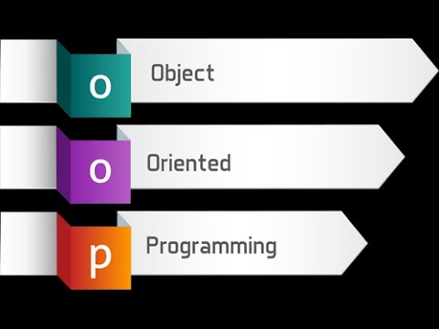
Creating Classes with C#
Chapter - 9

Slide 2
Class and object concepts
Classes are an encapsulation of data properties and data methods.
The properties are used to describe the data the class will be holding.
The methods tell what are the operations that can be performed on the data.
An object is an instance of a class, and the process of creating an object is called instantiation.
Most of the classes you create will have fields, properties, methods, events and constructors.
Notes:
https://www.youtube.com/watch?v=iGR425gMKeA

Slide 3
The members of a product class

Slide 4
The Product class: Fields and constructors

Slide 5
The Product class: The Code property

Slide 6
The Product class: The Description property

Slide 7
The Product class: The Price property

Slide 8
The Product class: The GetDisplayText method

Slide 9
Two Product objects that have been instantiated from the Product class

Slide 10
Code that creates these two object instances

Slide 11
Constructors and object instantiation
When an object is instantiated, a constructor is executed to initialize the data that makes up the object. If a class doesn't provide a constructor, a default constructor is executed.
The default constructor simply initializes all the data to default values.
An application can create two or more instances of the same class. Each instance is a separate entity with its own state. If you change the state of one object, the state of other objects created from the same class is not affected.
Object initializers let you create an instance of an object and assign values to that object in a single statement without explicitly calling a constructor.
A class defines a reference type. That means that the variable that's used to access an object instantiated from a class contains the address of the object, not the actual object.

Slide 12
How to create A CLASS
To add a new class to a project, right click on the Project → Add New Item. Then, FROM THE DIALOG BOX SELECT Visual c# class. Enter the name you want to use for the new class and click the Add button.
When you complete the Add New Item dialog box, a class file is added to the project.
This class file will appear in the Solution Explorer window with the extension .cs
The namespace and class blocks are automatically added to the class. Then, you can enter the code for the class within the class block.

Slide 13
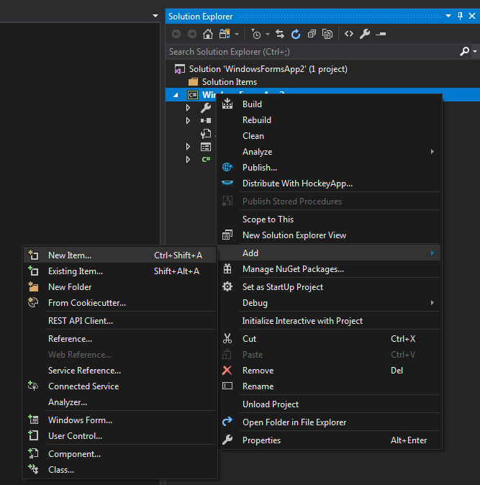
How to create a class

Slide 14
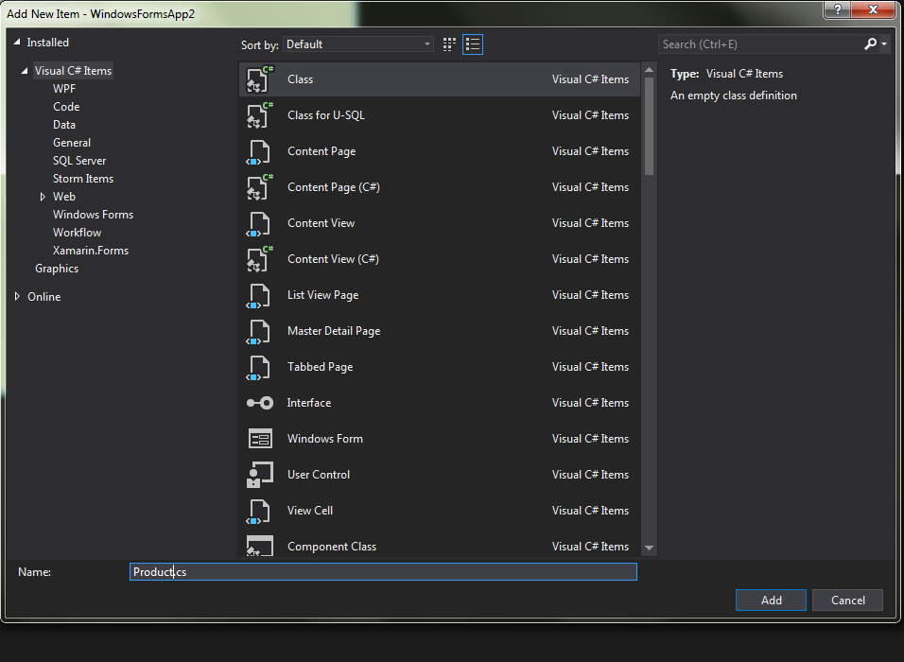

Slide 15
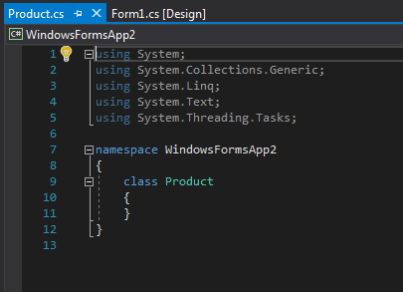

Slide 16
How to code fields
A variable that's defined at the class level within a class is called a field.
A field can be a primitive data type, a class or structure from the .NET Framework, or a user-defined class or structure.
You can use the private access modifier to prevent other classes from accessing a field. Then, the field can be accessed only from within the class.
An instance variable is a field that's defined in a class and is allocated when an object is instantiated. Each object instance has a separate copy of each instance variable.

Slide 17
How to code fields
If you initialize an instance variable, the initialization will occur before the constructor for the class is executed. As a result, the constructor may assign a new value to the variable.
You can create a read-only field by specifying the readonly keyword in the field's declaration. Then, the field's value can be retrieved, but it can't be changed. You can set the value for a read-only field when you declare it or in the code for a constructor.
A public field is a field that's declared with the public access modifier. Public fields can be accessed by other classes within the application.

Slide 18
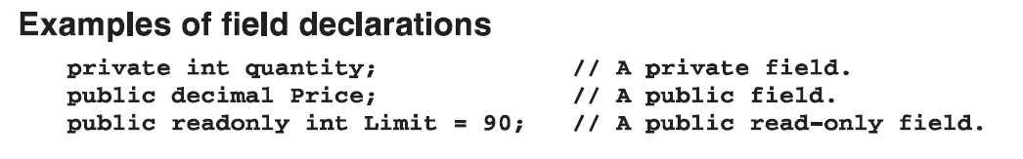

Slide 19
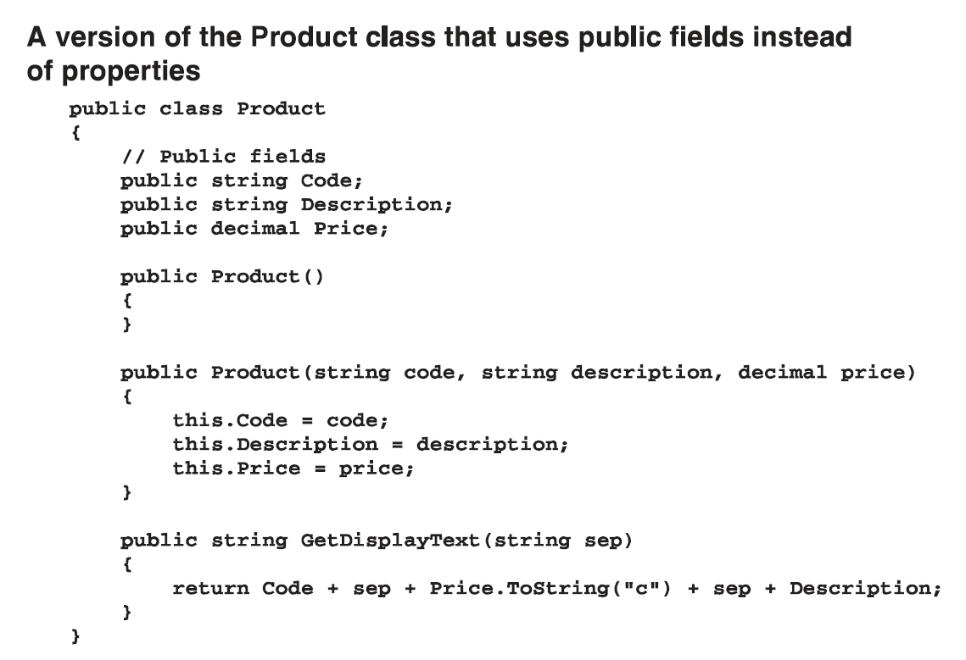

Slide 20
What are properties
Properties allow you to access class data in a safe and flexible way.
Properties are named members of classes, structures, and interfaces. Member variables or methods in a class or structures are called Fields.
Properties are an extension of fields and are accessed using the same syntax. They use accessors through which the values of the private fields can be read, written or manipulated. Properties do not name the storage locations. Instead, they have accessors that read, write, or compute their values.

Slide 21
What are properties
Properties are class members that can be accessed like data fields but contain code like a method.
Properties are often used to expose the data fields of a class in a more controlled manner.
For example, let us have a class named Student, with private fields for age, name and code. We cannot directly access these fields from outside the class scope, but we can have properties for accessing these private fields

Slide 22
What are properties
A property has two accessors
Get: The get accessor is used to return the property value and the get { } implementation must include a return statement. It can access any member on the class.
Set: The set accessor is used to assign a new value to the property and the set { } implementation receives the implicit argument "value." This is the value to which the property is assigned.
A property is often defined as public and, by convention, always has a name that begins with a capital letter. In contrast, the convention for naming private data fields is to begin with a lower-case letter.

Slide 23
How to code properties
You use a property to get and set data values associated with an object. Typically, each property has a corresponding private instance variable that stores the property's value.
It's common to use the same name for the property and the related instance variable, but to begin the property name with an uppercase letter and the instance variable name with a lowercase letter.
You can code a get accessor to retrieve the value of the property. Often, the get accessor simply returns the value of the instance variable that stores the property's value.

Slide 25
How to code properties
If no additional code is required in the get and set accessors, you can create an auto- implemented property. Then, a corresponding private instance variable is created automatically, and that variable is only accessible through the property.
A property that has both a get and a set accessor is called a read/write property.
A property that has just a get accessor is called a read-only property.
And a property that has just a set accessor is called a write-only property.

Slide 26
Writing an auto implemented property thru’ a code snippet
Code snippets have been around for a long time and is one of the easiest ways for the developer productivity.
For an instance, a very useful time saver code snippet is “prop” which is use for “Automatically implemented property” .
Right click and select Snippet -> Insert Snippet (1)
Select C# folder and a list is shown(2)
Select prop and press TAB key twice, an automatic property will be added with default type of int .(3,4)
you can use propfull which gives you a private backing variable and then a public GET and SET with the link of just declared private variable. (5)

Slide 27
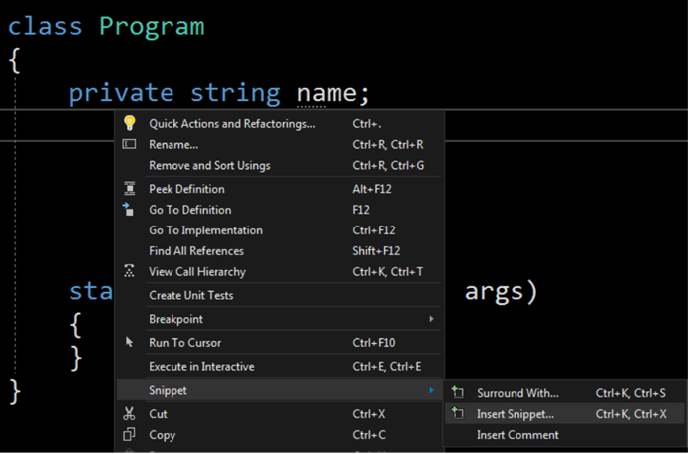
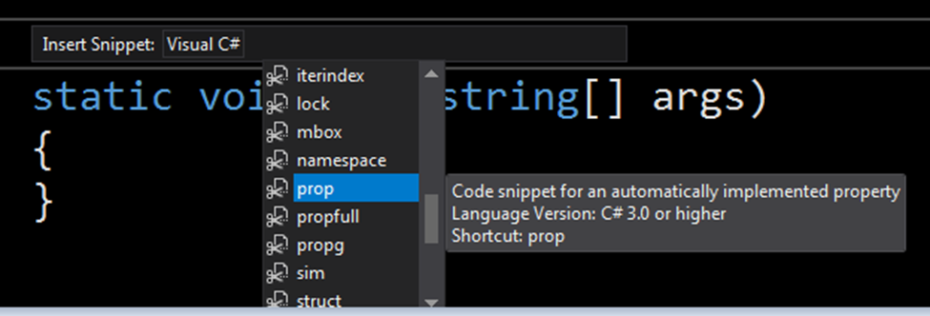
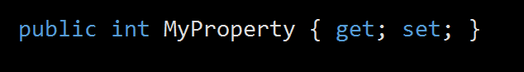
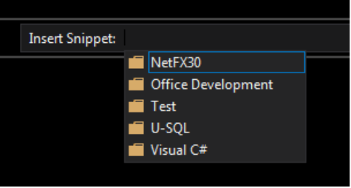
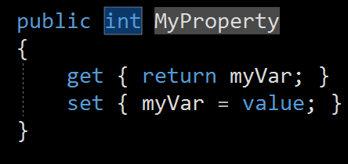
1
3
4
2
5

Slide 28
How to code methods
To provide other classes with access to a method, you declare it using the public access modifier. To prevent other classes from accessing a method, you declare it using the private access modifier.
The name of a method combined with its parameters form the method's signature.
Although you can use the same name for more than one method, each method must have a unique signature.
When you create two or more methods with the same name but with different parameter lists, the methods are overloaded. It's common to use overloaded methods to provide two or more versions of a method that work with different data types or that supply default values for omitted parameters.
When you type a method name followed by a left parentheses, the IntelliSense feature of Visual Studio displays the parameters expected by the method. If up and down arrows are displayed as shown above, you can click these arrows or press the up and down arrow keys to display each of the method's overloaded parameter lists.

Slide 30
How to code constructors
The name of a constructor must be the same as the name of the class. In addition, a constructor must always be declared with the public access modifier, and it can't specify a return type.
To code a constructor that has parameters, code a data type and name for each parameter within the parentheses that follow the class name.
The name of a class combined with its parameter list form the signature of the constructor. Each constructor must have a unique signature.
If a constructor doesn't assign a value to an instance variable and the variable hasn't been initialized, the variable will be assigned a default value.

Slide 31
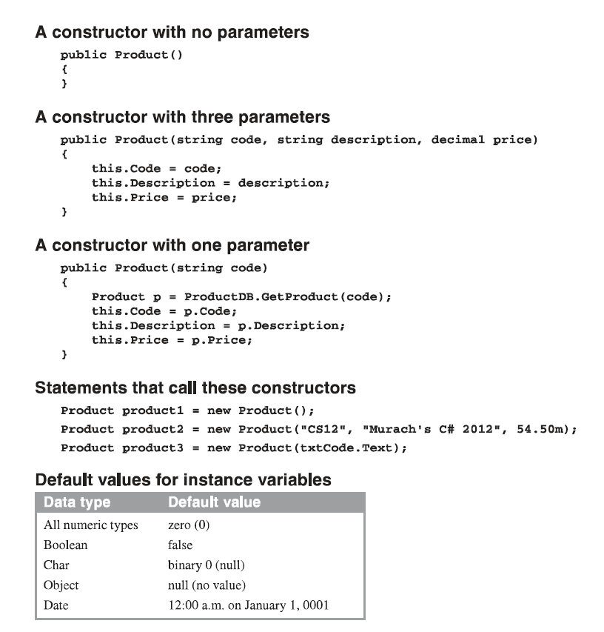

Slide 32
Hoe to code static members
Static members are members that can be accessed without creating an instance of a class.
The idea of static members shouldn't be new to you because you've seen them earlier. In chapter 4, for example, you learned how to use static methods of the Math and Convert classes. And in chapter 8, you learned how to use static members of the DateTime structure and the String class.
This figure in the next slide shows how to create static members in your own classes.
To create a static member, you simply include the static keyword on the declaration for the member. The class shown in this figure, for example, provides static members that can be used to perform data validation. This class has a static field named title, a static property named Title, and a static method named IsPresent.

Slide 33
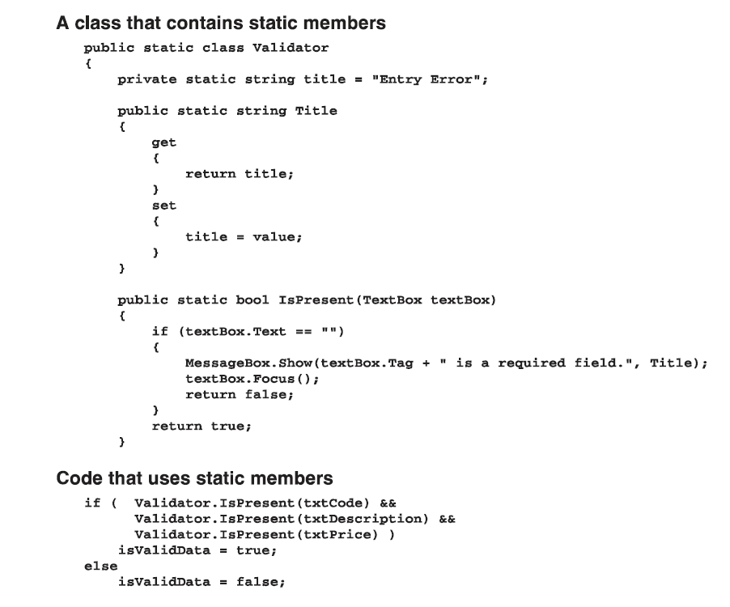

Slide 34
How to code static members
Static properties and methods can refer only to other static members or to variables declared within the property or method.
A constant that's declared with the public keyword is implicitly static. You can't code the static keyword on a constant declaration.
If you create an object from a class, you can't refer to a static member through the variable for the object. You can refer to a static member only through the name of the class.
If a class only contains static members, you can use the static keyword in the class declaration to declare the class as a static class. This prevents programmers from accidentally adding a non-static member to the class or from creating an object from the class.

